Slide 1



The Information Delivery Services (IDS) Project:
State of the Project
Ed Rivenburgh
SUNY Geneseo
IDSProject.org
2008 IDS Conference
Notes:
ALA OCLC Presentation

Slide 2


Slide 3
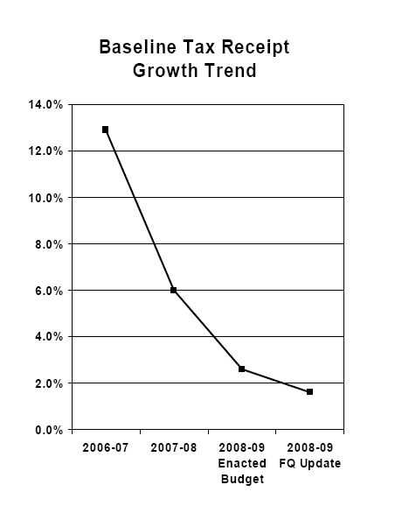

Slide 4
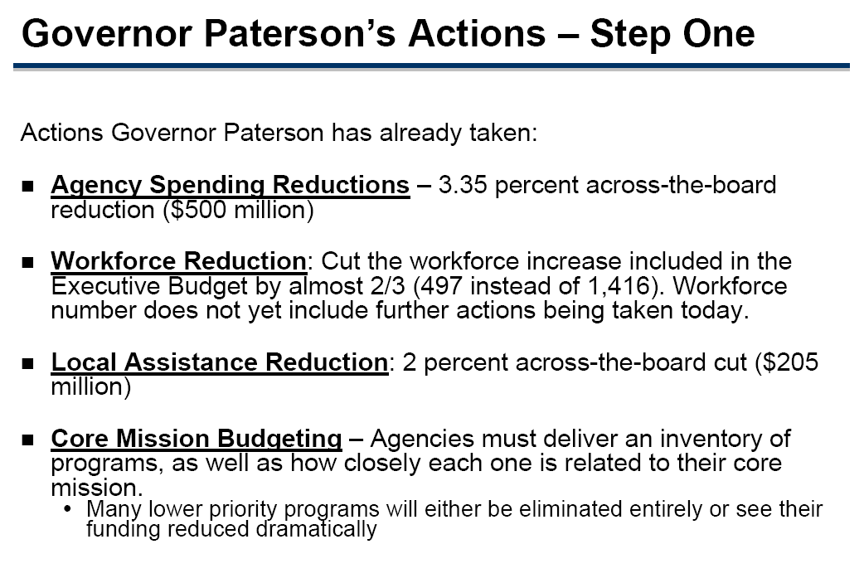

Slide 5
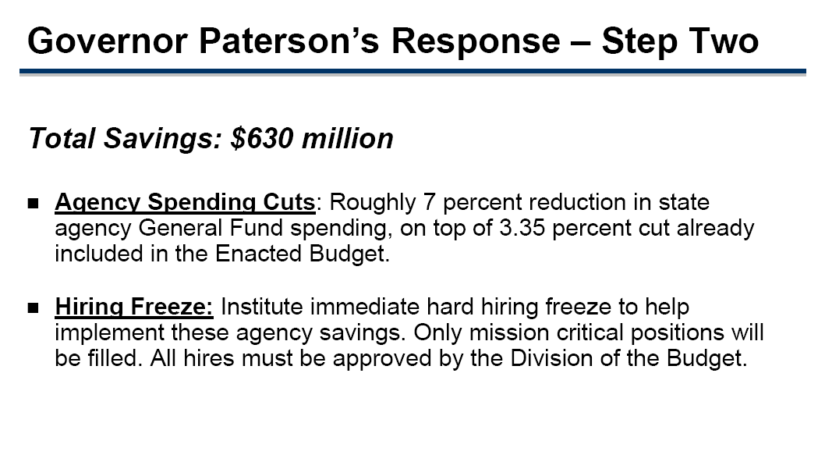

Slide 6
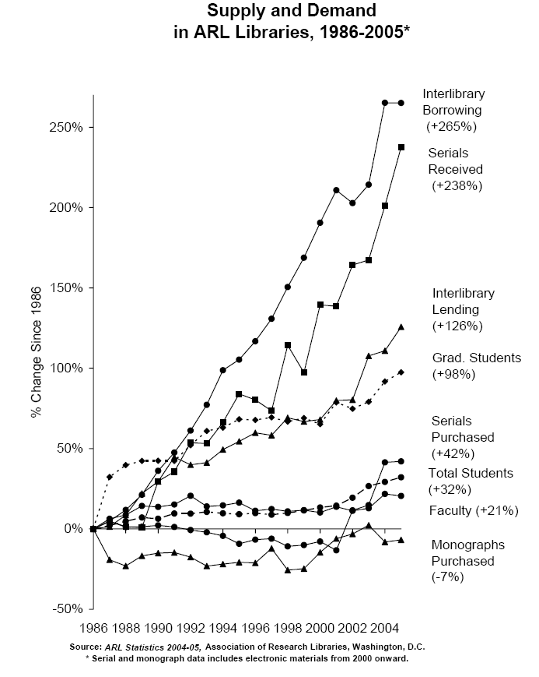
Interlibrary
Borrowing
(+265%)
Interlibrary
Lending
(+126%)
Serials
Purchased
(+42%)
Monographs
Purchased
(-7%)

Slide 7
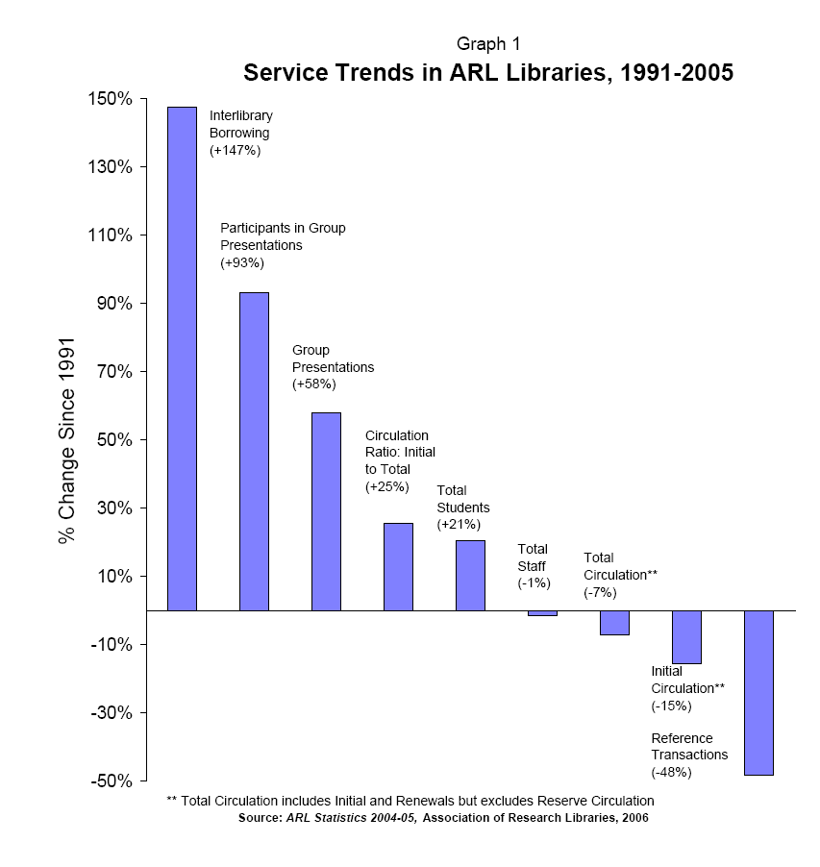
Interlibrary
Borrowing
(+147%)
Initial
Circulation**
(-15%)
Reference
Transactions
(-48%)

Slide 8

Scary Idea # 1:
“My Library is Your Library!”
“Your Library is My Library!”

Slide 9

Scary Idea # 2:
“My Fate is in Your Hands!”
“Your Fate is in My Hands!”

Slide 10
Scary Idea # 3:
--Pogo

Slide 11
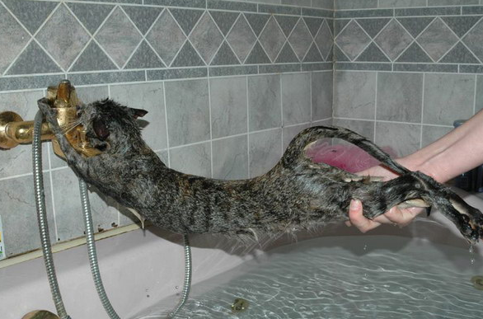

Slide 12


Slide 13

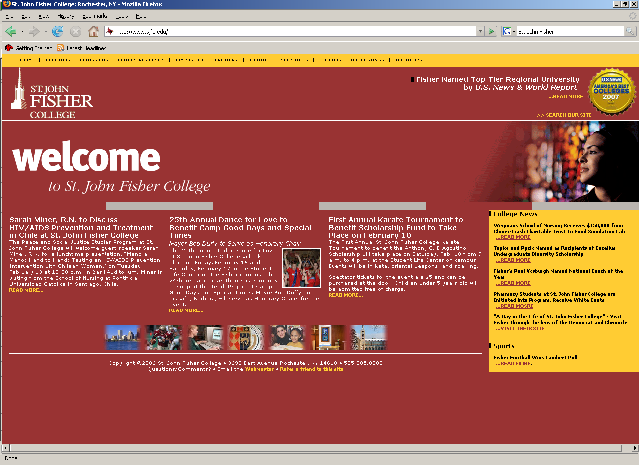













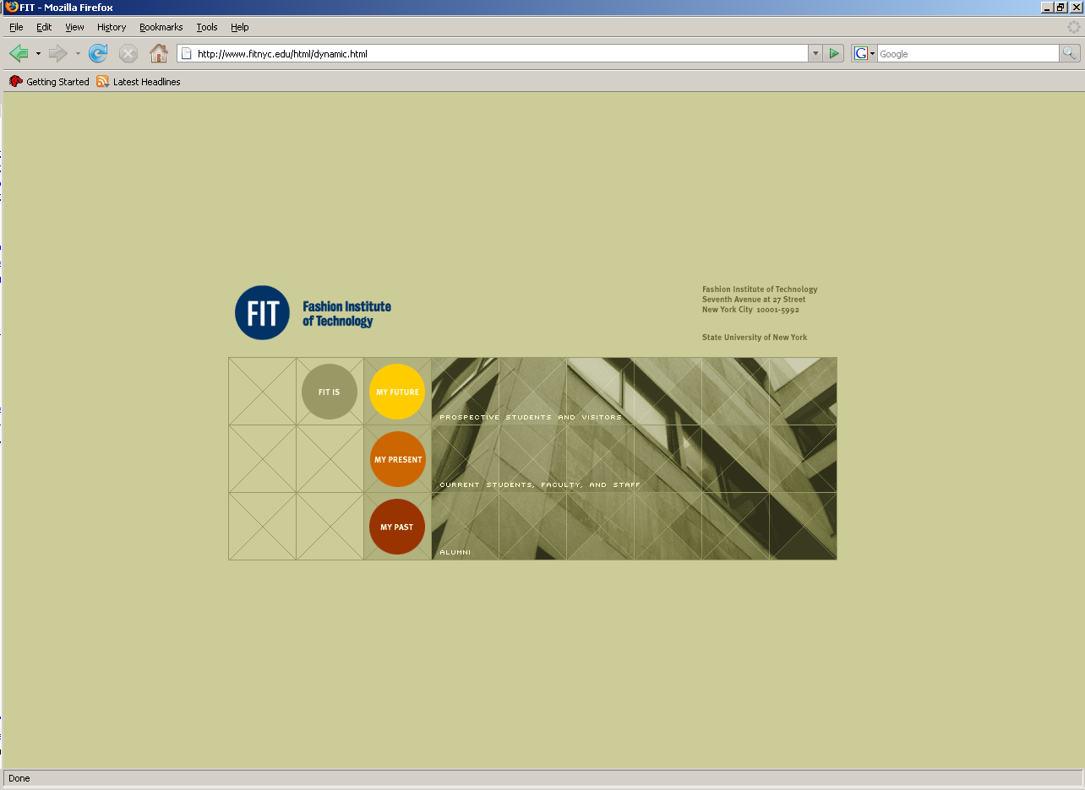
















IDS Project
Summer 2008
Student Head-Count: ~ 185,000
Faculty Head-Count: ~ 12,000
Total Volumes: ~ 12,500,000
CUNY

Slide 14
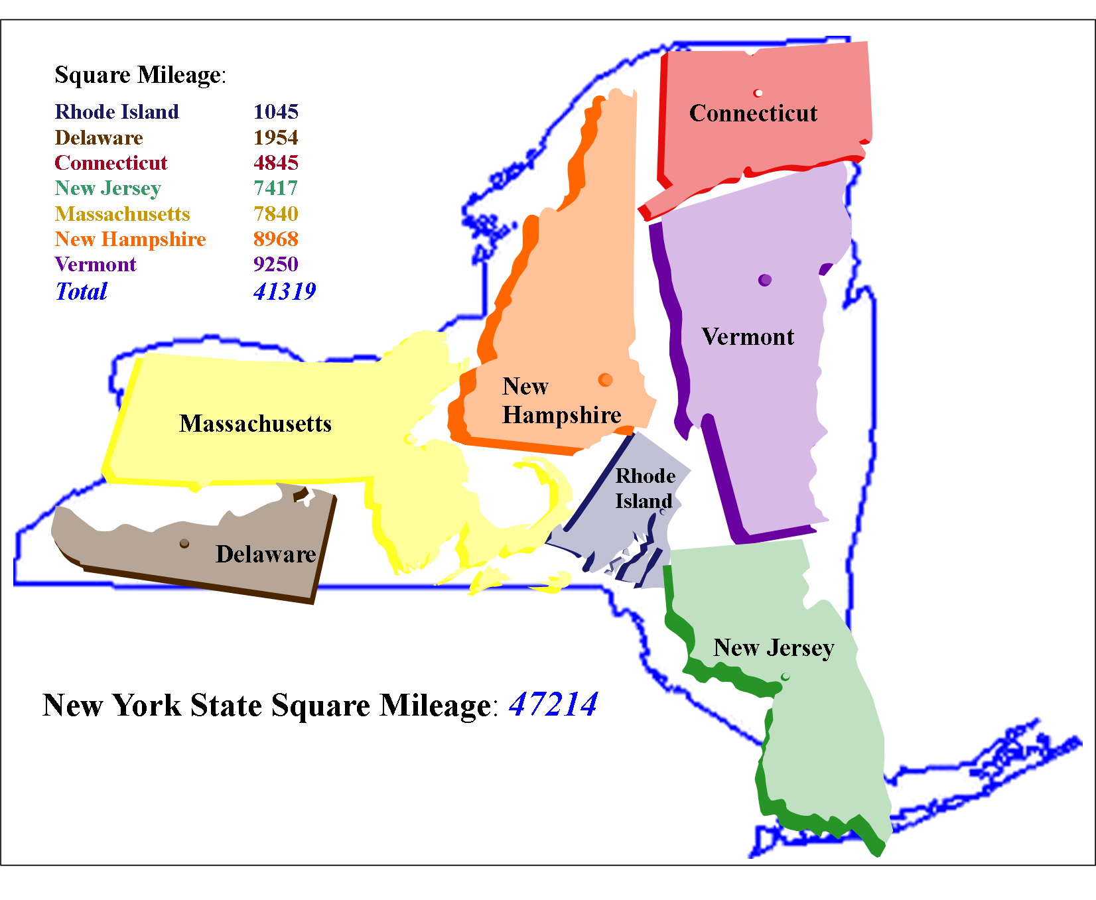

Square Mileage:
Rhode Island 1,045
Delaware 1,954
Connecticut 4,845
New Jersey 7,417
Massachusetts 7,840
New Hampshire 8,968
Vermont 9,250
_________________________________________________
Total 41,319
Massachusetts
47,214
14

Slide 15
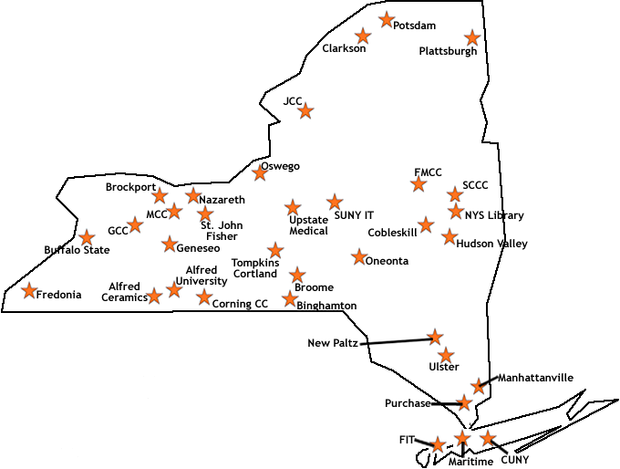
Current Libraries

Slide 16
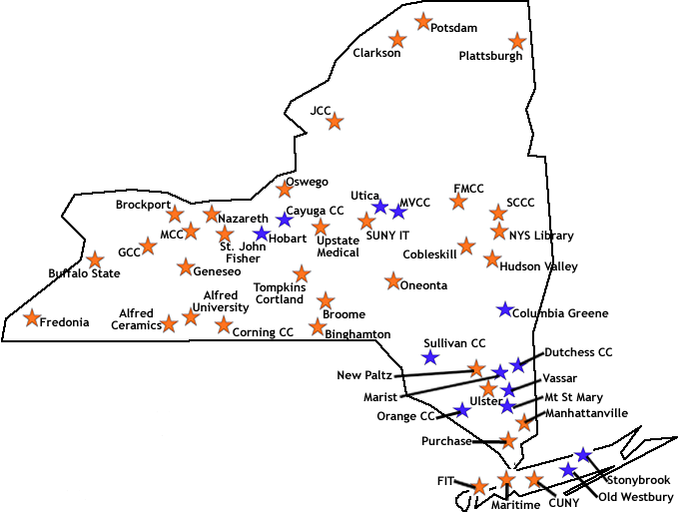

Slide 17
TOTAL IDS PROJECT
TRANSACTIONS
JANUARY 2004 0
APRIL 2008 ~160,000
2008 IDS Conference
17

Slide 18
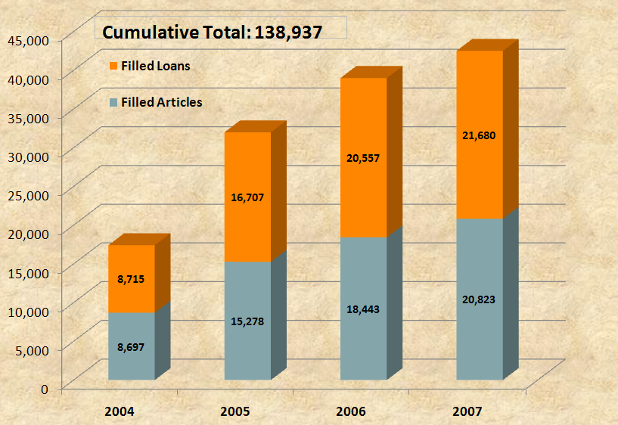
Outcomes
2008 IDS Conference
18
Notes:
APRIL 2008 ~160,000

Slide 19
Notes:
Speed of delivery – how did we do matching our benchmarks?

Slide 20
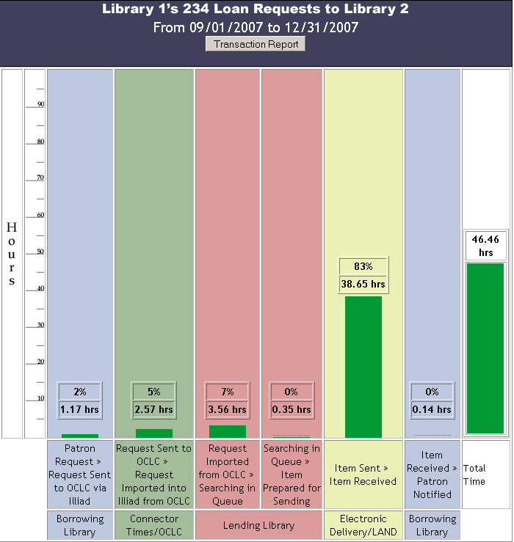

Slide 22
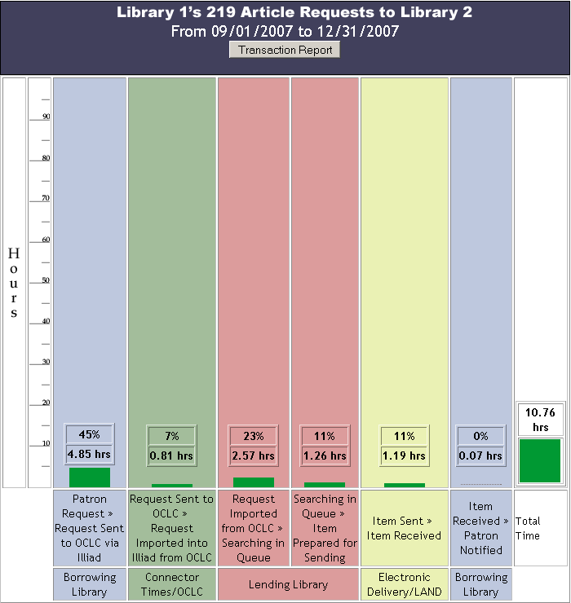

Slide 23
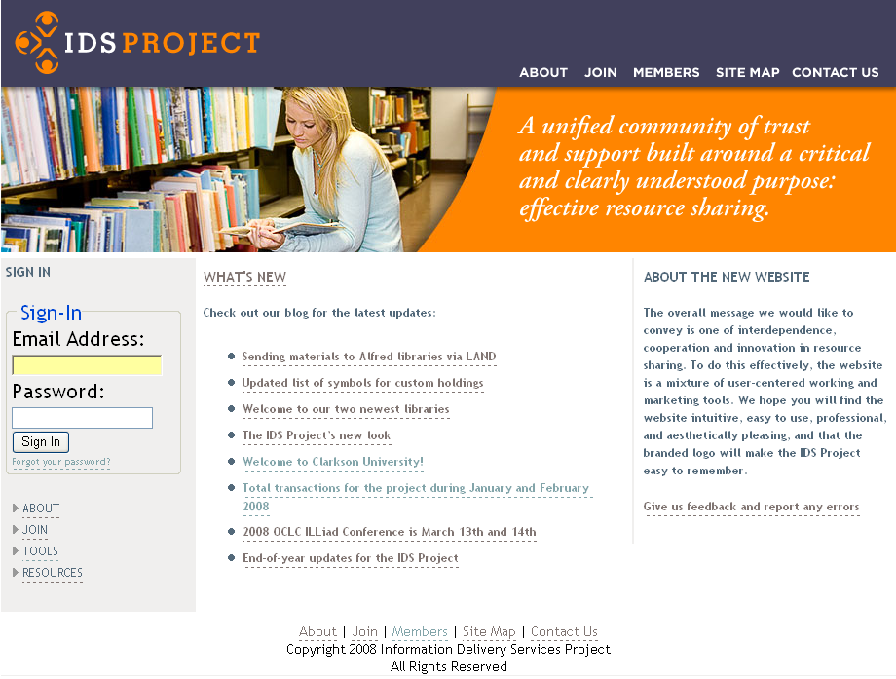

WHAT’S NEW
Check out our blog for the Latest updates:
Sending materials to Alfred libraries via LAND
Updated list of symbols for custom holdings
Welcome to our two newest libraries
The IDS Project’s new look
Welcome to Clarkson University!
Total transactions for the project during January and
February 2008
2008 OCLC ILLiad Conference is March 13th and 14th
End of year updates for the IDS Project
Download the IDS Project
presentation
here (.zip file)
23
Notes:
Discuss photos and contact information for all staff and directors, Summer Conference – group meetings, practitioner discussion groups, and evening social events.

Slide 24

ILLiad Conference – March 13, 2008
24

Slide 25

IDS PROJECT.ORG
2008 IDS Conference
25

Slide 26
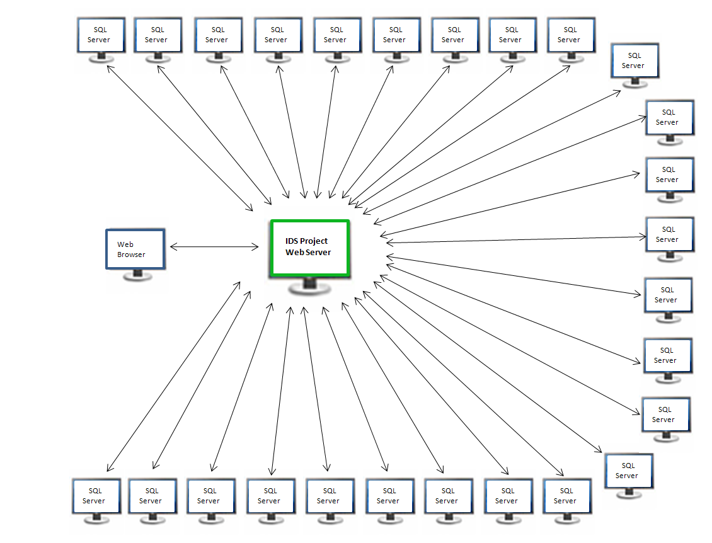
26

Slide 27
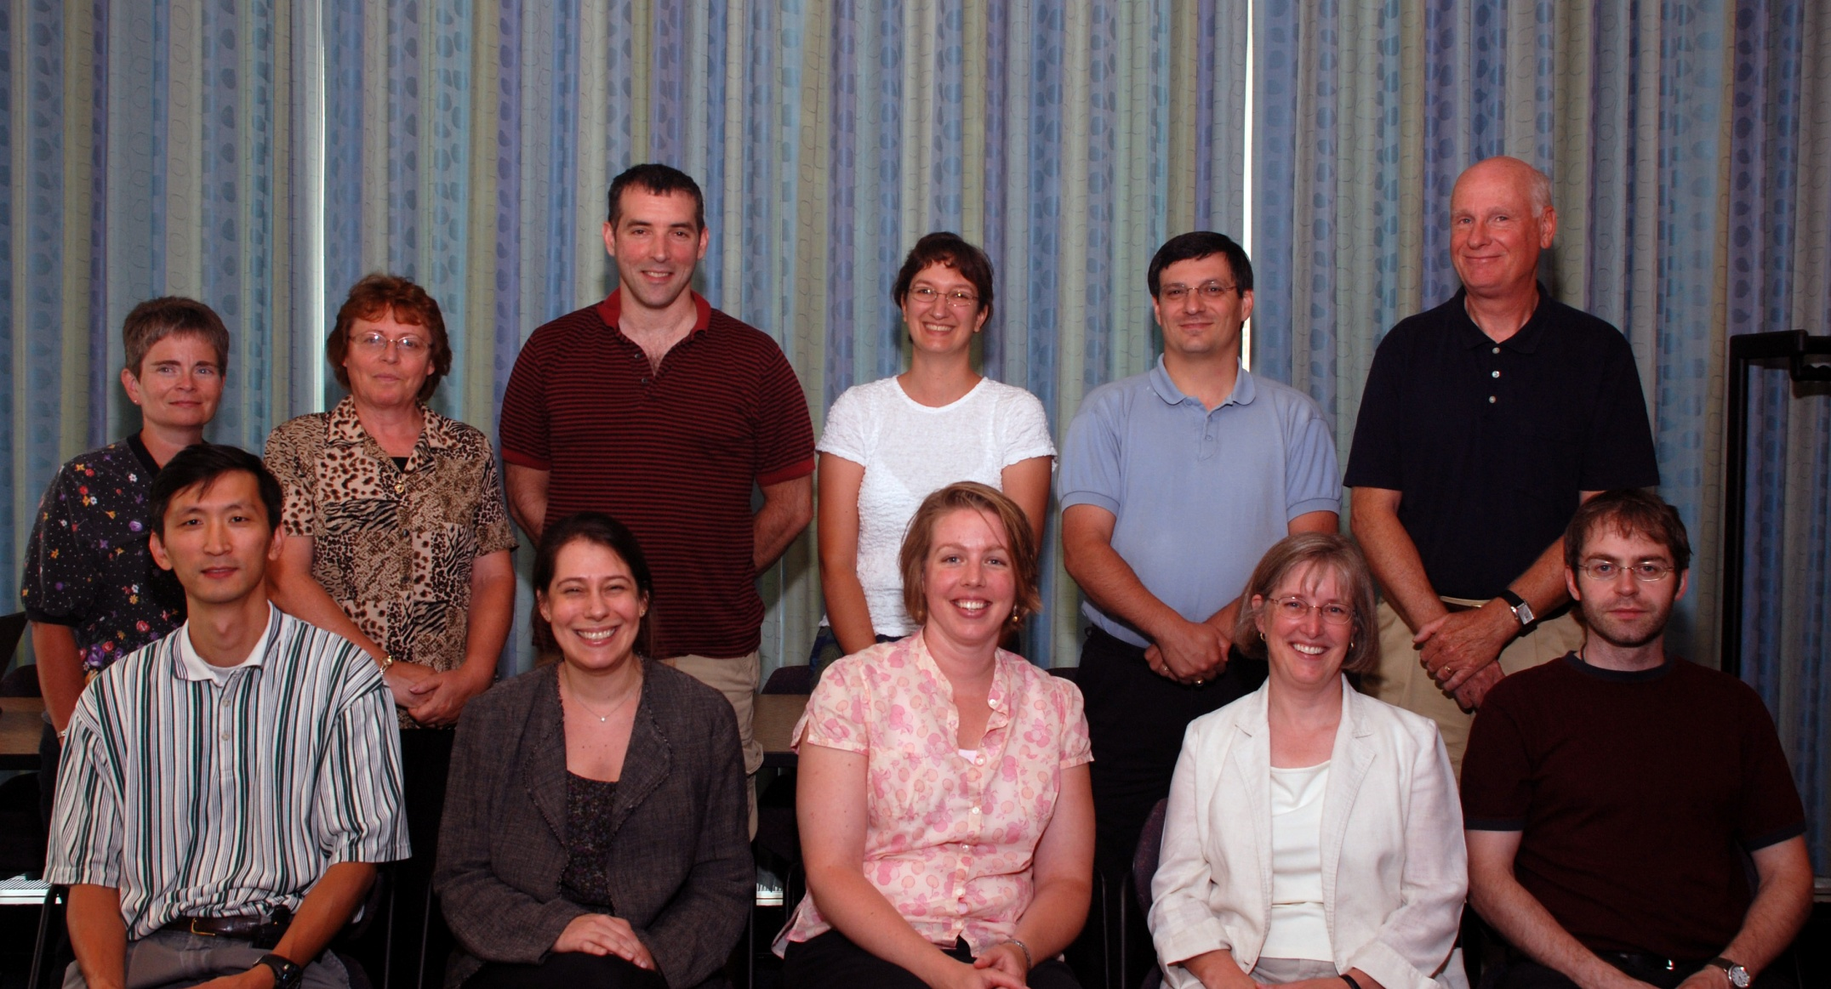
Back: Janet Ferry, Harriet Sleggs, Gregg Kiehl, Chris Sisak, Mark Sullivan, Andy Perry
Front: Corey Ha, Beth Posner, Carrie Eastman, Michelle Parry, Mike Curtis
27
2008 IDS Conference
27
Notes:
TRAINED TEAMS of volunteer mentors – applications and technical mentors – elaborate.

Slide 28



Slide 29
KUDZU/IDS Pilot Project Participants
Clemson University
Eastern Carolina University
University of Alabama
University of Mississippi
University of South Carolina
University of Tennessee
Vanderbilt University
Virginia Commonwealth University
2008 IDS Conference
Hand
out

Slide 30






Thank You
SUNY ’s Office of
Library and
Information Services
2008 IDS Conference
30
Notes:
Add Serials Solutions?

Slide 31
2009 Objectives:
Raise average fill rate for loans and articles to 50%
Research ways to load level among project libraries
Continue to evaluate and improve mentor program
2008 IDS Conference

Slide 32
2009 Objectives:
Continue to develop and share best practices for resource-sharing with the NY3R’s, OLIS, Nylink, ConnectNY and other ILLiad communities
Have strong IDS Project representation at the Nylink Resource-sharing Summit (October 23-24, 2008)
Insure that all mentors attend the 2009 Annual OCLC/ILLiad International Conference
2008 IDS Conference
Notes:
$40K is the actual dollar amount used in the project to date, money came from SUNY OLIS and 3Rs grants.

Slide 33
2009 Objectives:
7. Institute IDS Project Advisory Council
    Review Project Goals & Objectives
    Provide general guidance for project team
    Assist in development of a strategic plan
2008 IDS Conference

Slide 34
Strategic Issues
a. Future of membership -- museums, article only?
b. Growth: Scalability, Community, Sustainability
c. Improve communication between project team
and members and among members
d. Cumbersome bureaucracy versus nimbleness
in taking advantage of unexpected opportunities
e. Future of the Conference
2008 IDS Conference

Slide 35
2009 Objectives:
Develop knowledge-sharing partnerships with other resource-sharing consortia.
9. Work with NY3Rs to increase interconnections between the academic libraries in their regions and the IDS Project.
10. Support statewide efforts for coordinated collection development initiatives among academic libraries.
2008 IDS Conference

Slide 36
2009 Objectives:
11. Encourage membership of additional SUNY, CUNY, and private academic libraries in the IDS Project.
Begin 3-year IMLS Grant in December 2008 or rewrite grant for submission in January 2009.
13. Plan next year’s IDS Conference (August 4-5, 2009).
2008 IDS Conference

Slide 37
2009 Objectives:
Upgrade to ILLiad 8.0.
15. Implement an IDS Project Technology Development Group.
16. ALIAS
a. Article Direct Request – Unmediated Borrowing
b. And more coming…
2008 IDS Conference

Slide 38
IDS PROJECT.ORG
Do we have the individual—and collective will to meet today’s user’ demands for information by dramatically transforming the current operations within our individual libraries—and by radically reshaping the historical organizational relationships among our libraries?
2008 IDS Conference
38

Slide 39
Thank you
IDS Project Contact Information
URL: IDSProject.org
39
2008 IDS Conference

Slide 43
Major Features of IDS Project
Emphasis on building “a unified community of trust & support”
Trained teams of volunteer mentors (applications & technical)
User-centric definition of an ILL transaction
Handle both physical items (books, media, etc) AND articles
Contractual performance standards
Real-time, multi-level ILL transaction performance data
Objective data for decision making & policy development
Extensive sharing of eJournals via eJournal Availability Server
No startup or annual membership fees
Commitment of talent and time of members
2008 IDS Conference

Slide 44
A unified community of trust and support built around a critical and clearly understood common purpose: effective resource sharing.
2008 IDS Conference
44

Slide 45
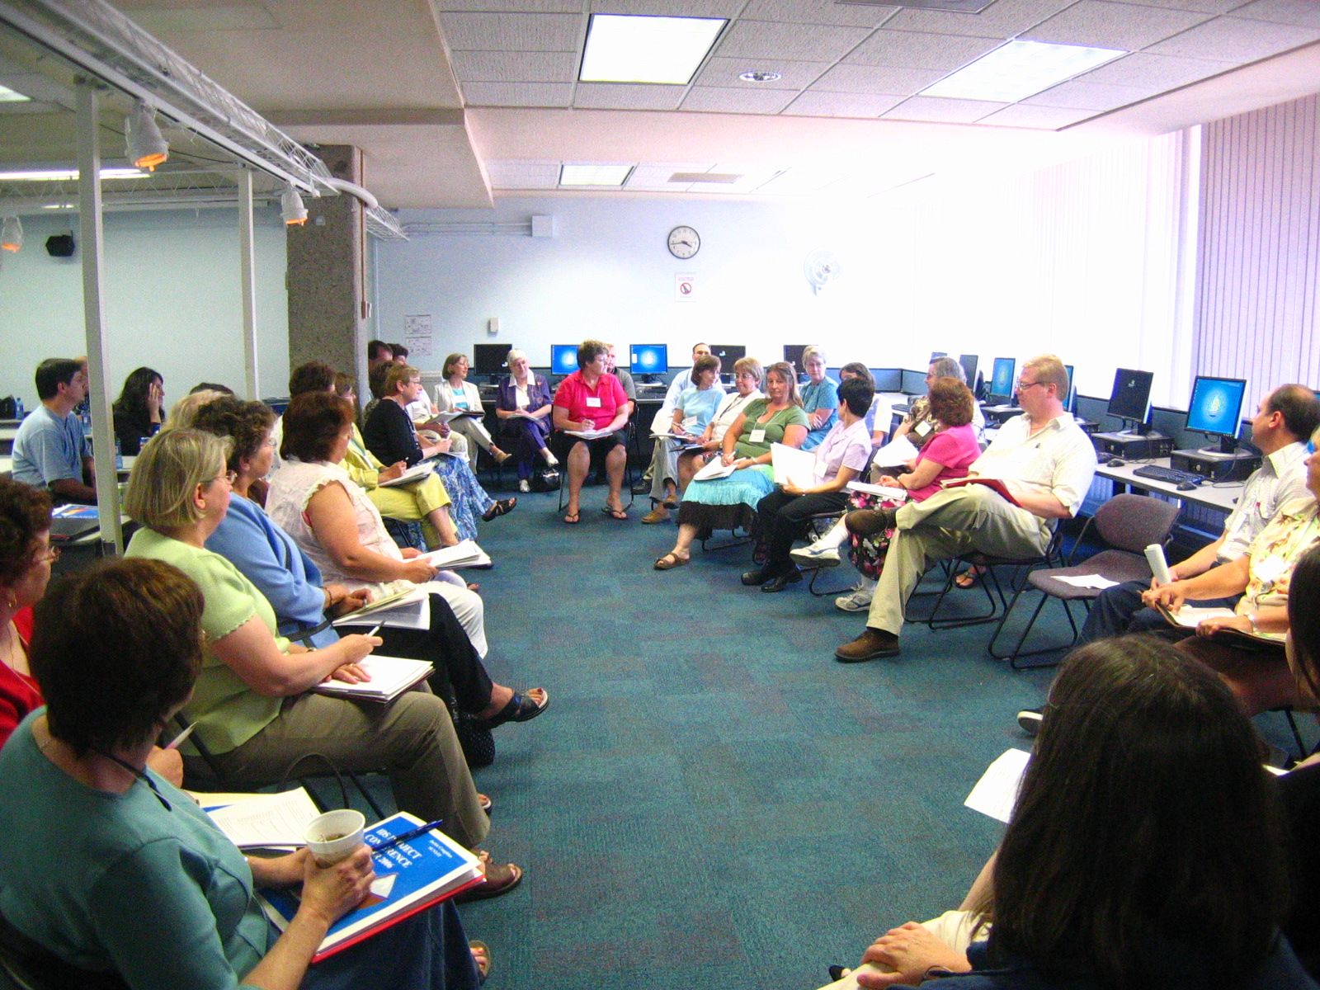
2008 IDS Conference
45

Slide 46
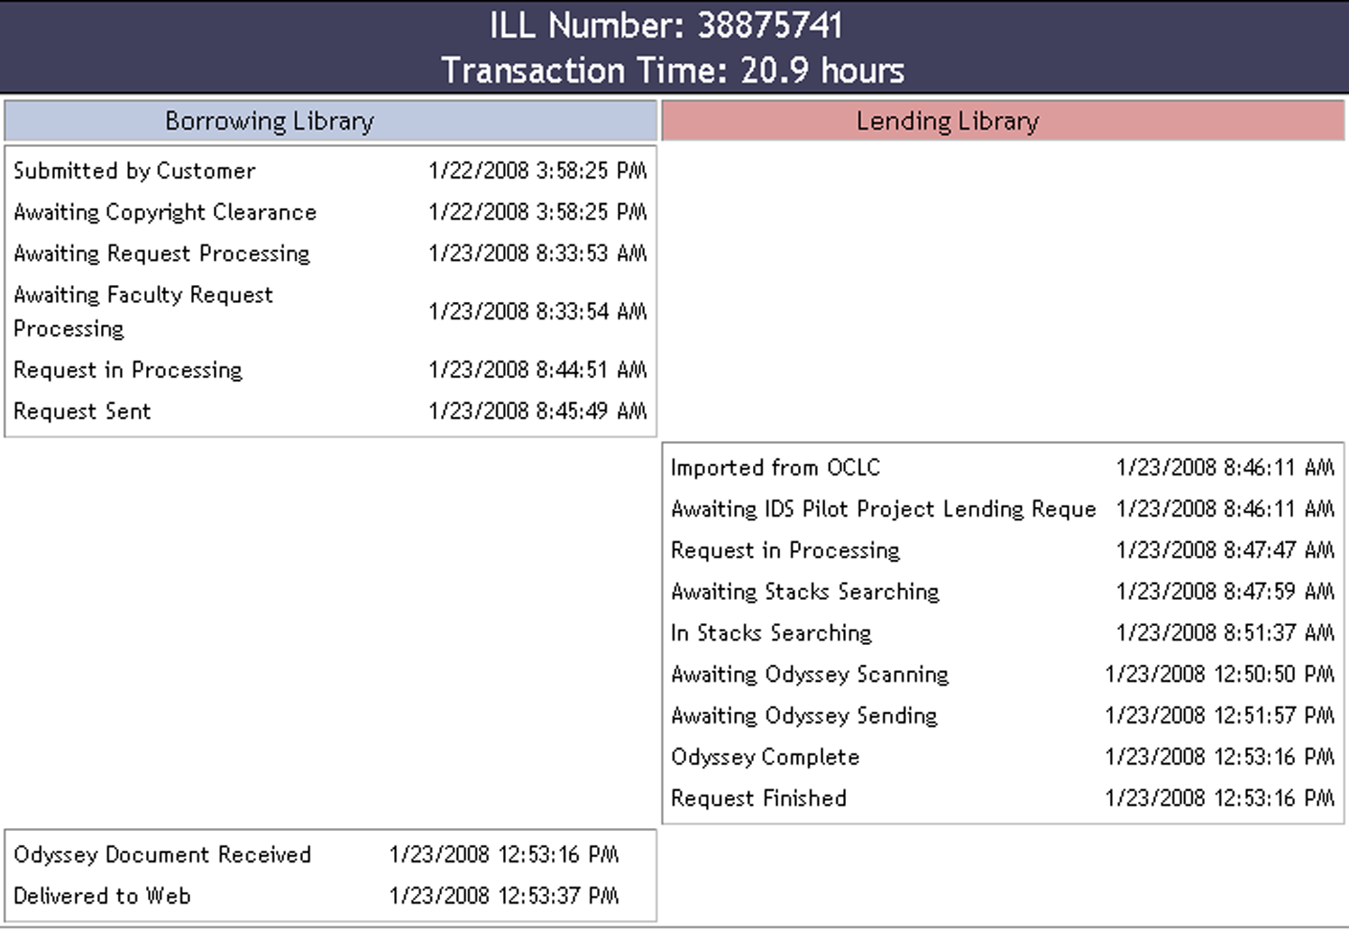
Individual ILL Transaction Report
46

Slide 47
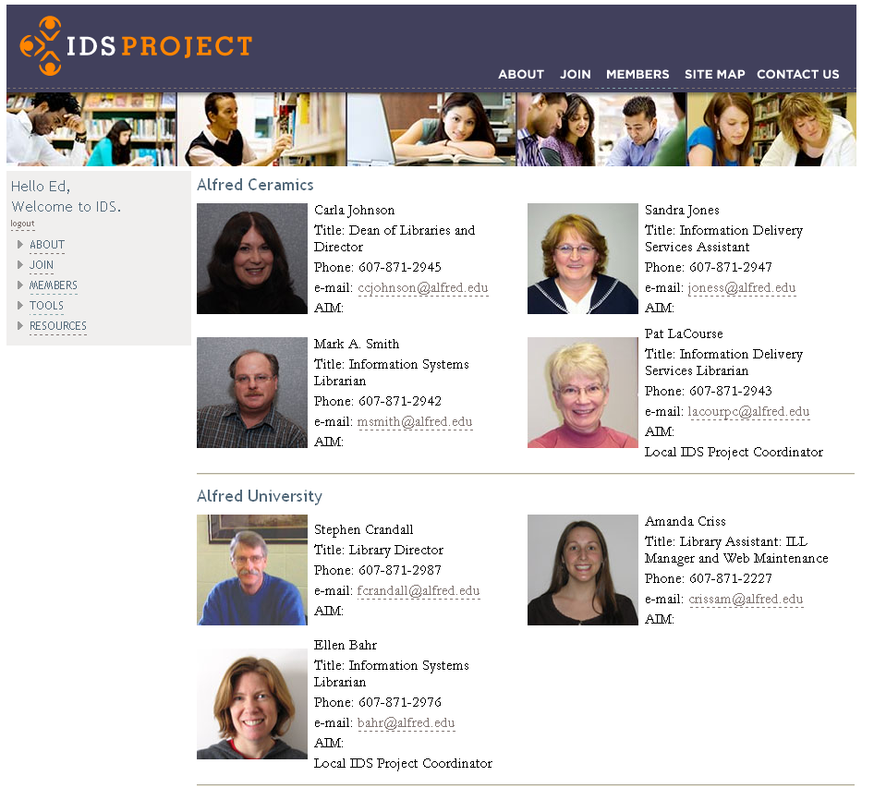
47

Slide 48
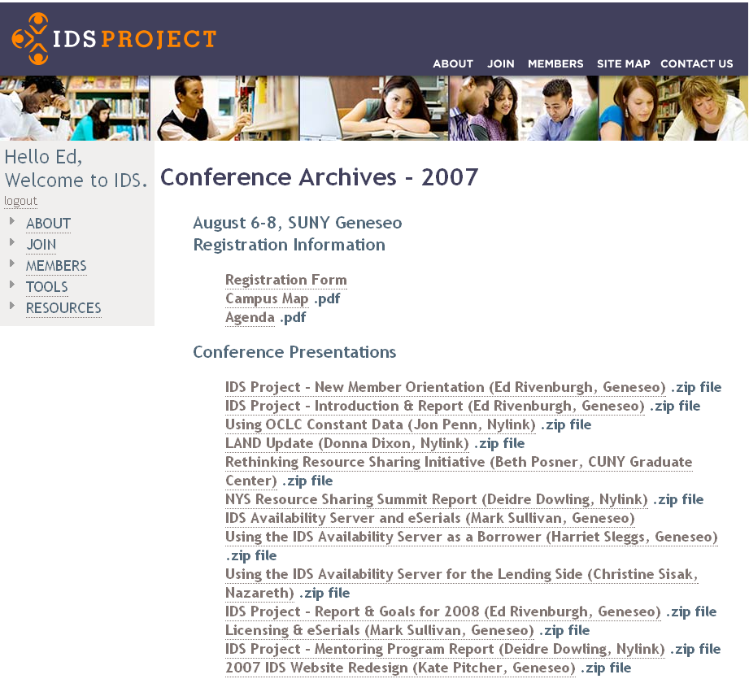
48

Slide 49
User-centric Definition of IDS Transaction
From the time the user places a request until the time the user is notified the loan is ready for pickup or the article is ready to be retrieved from the Web
2008 IDS Conference

Slide 50
Adherence to contractual performance standards
Articles: 48 hours
Loans: 72 hours
(Weekends and Holidays Excluded)
2008 IDS Conference
50
Notes:
Besides turn-around times…
Ensure that all transmitted items meet requirements for bibliographic accuracy and high-quality reproduction
Mutual accountability – Trust but verify… Real-time, multi-level ILL transaction performance data

Slide 51
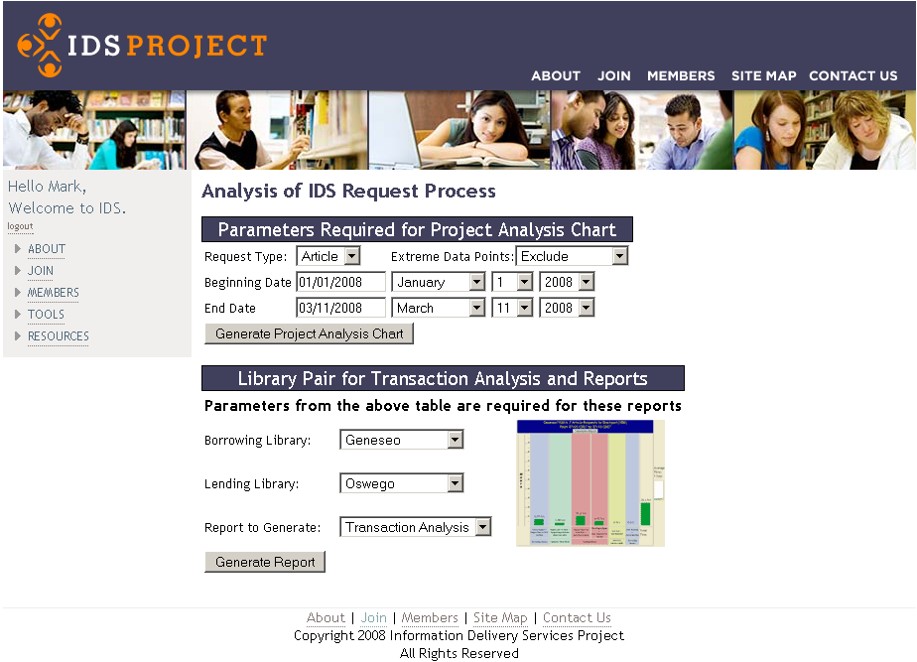
51

Slide 52
Project Overview Chart
52

Slide 53

Process Overview Chart
Library 1’s 34 Article Requests to Library 2
From 01/01/2008 to 03/11/2008
Transaction Report
53

Slide 54
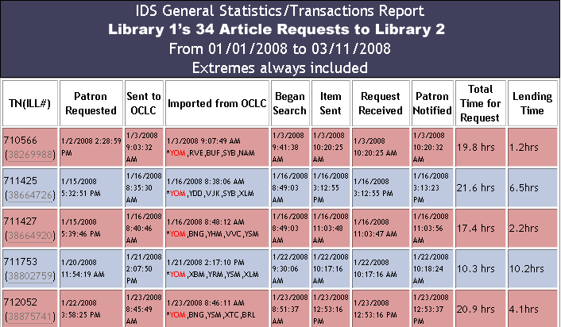
Transactions Report Table
IDS General Statistics/Transaction Report
Library 1’s 34 Article Requests to Library 2
From 01/01/2008 to 03/11/2008
Extremes always included
54

Slide 55
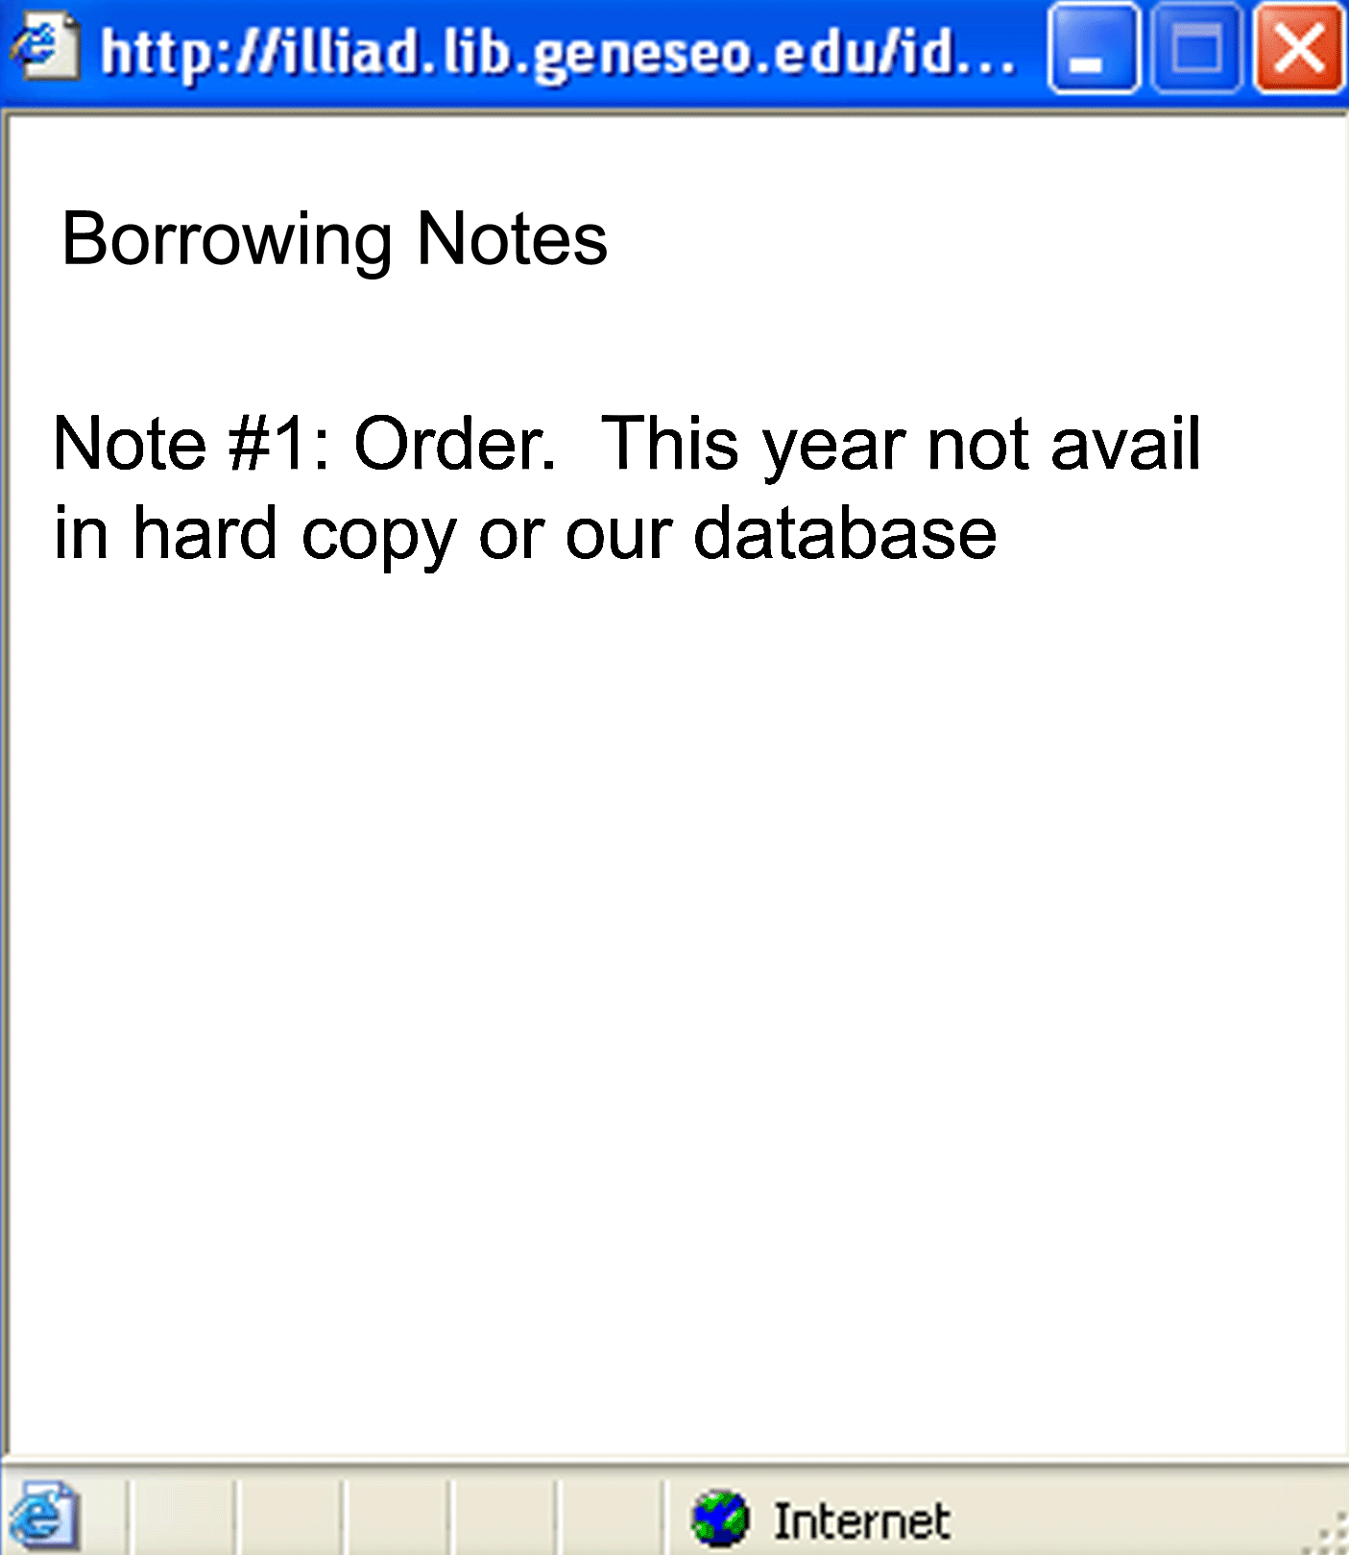
2008 IDS Conference
55

Slide 56
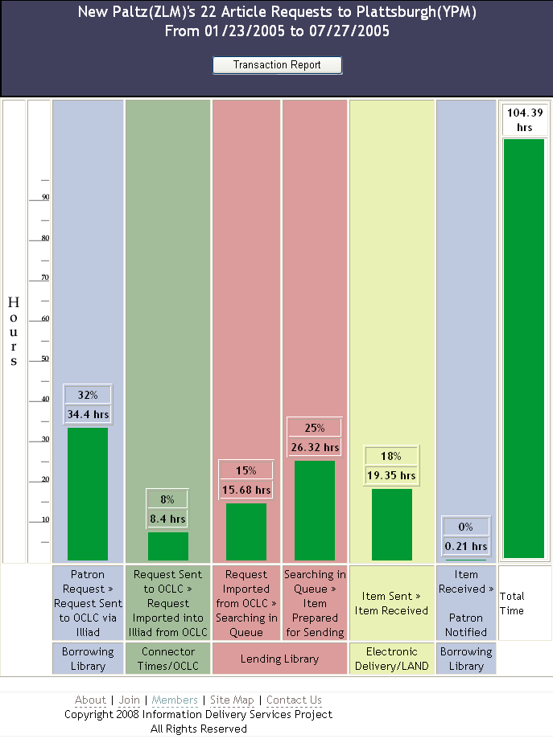
56
Notes:
Objective data for decision making & policy development

Slide 57
 | Libraries in Spring 2004 | Libraries in Spring 2005 | Libraries in Fall 2005 | Libraries in Spring 2006 | Libraries in Fall 2006
ILLIAD | 4 | 12 | 14 | 15 | 17
Odyssey | 2 | 10 | 12 | 13 | 15
Electronic Delivery to Web | 2 | 8 | 10 | 10 | 15
Custom Holdings (within Pilot Project) | 2 | 11 | 12 | 12 | 14
Direct Request in Use | 1 | 2 | 11 | 11 | 14

Slide 58
Library staff allocation and responsibilities – cross training
Work flow modifications
Staffing schedules
Odyssey Trusted Sender
58
2008 IDS Conference

Slide 59
Request Type | % filled within the Project
Loans | 39%
Articles | 35%
59
2008 IDS Conference

Slide 60
But we have more journals than that!
SUNY Oswego’s Current Journal Subscriptions
Electronic: ~35,000
Print: ~300

Slide 61
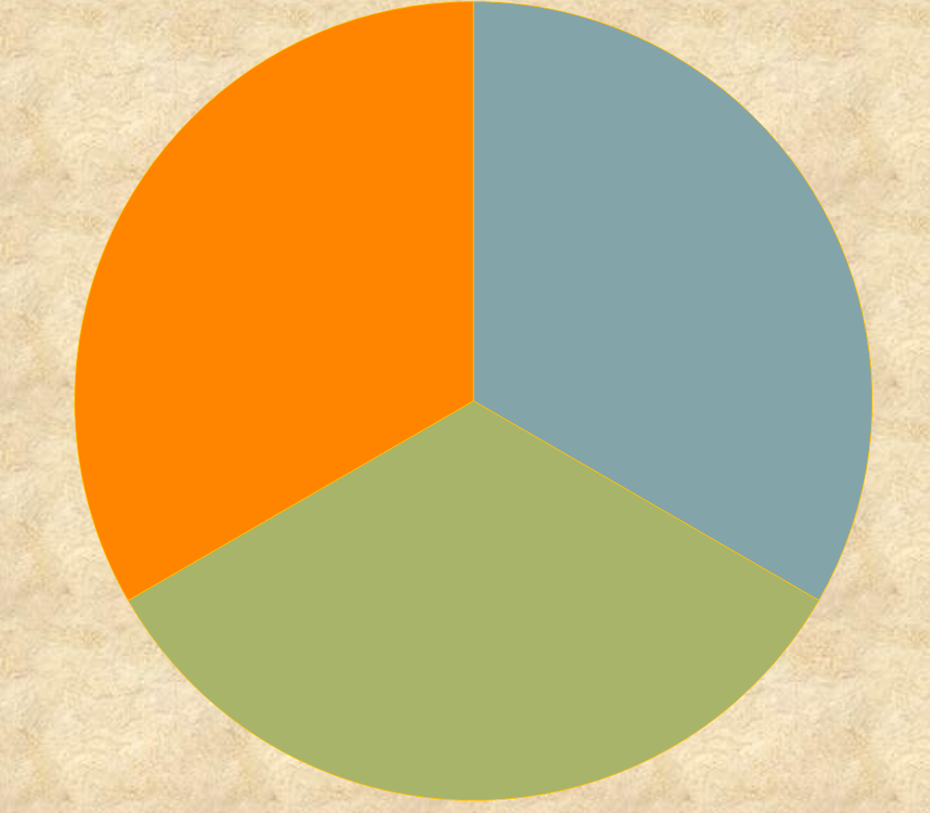
1/3 Article Requests filled within IDS Project
1/3 Article Requests unfillable within IDS Project
1/3 Article Requests fillable with Electronic Journals within IDS Project
2008 IDS Conference
61

Slide 62
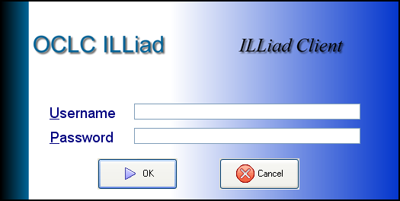
IDS Project eJournal Availability Server
IDS eJournal Availability Server
Z39.50 catalog displays ILL availability
Title, Year, Volume, Issue, License
Database of eJournals held by IDS Project libraries
Licensing Database
OpenURL
Resolvers
Notes:
Extensive sharing of eJournals via eJournal Availability Server

Slide 63

Search Process for Licenses
TARGETS | URL | License | Date Checked | Checked by | Comments
INSTITUTE OF PHYSICS JOURNALS | http://www.iop.org/EJ/librarians/-page= librarians/0031-9120/1#print | P | 2/28/2007 | Tiede | Under “librarians” page
Search for
Provider
in a
Search Engine
Enter
Information
in Database
Yes, No,
Unclear, etc.
This License
is Paper
Copy Only
1.
3.
2.
http://www.iop.org/EJ/librarians/-page=librarians/0031-9120/1#print
Q. What about interlibrary loans?
  A. Institutions October use hard copies derived directly or indirectly from the electronic edition of the publications for the purpose of inter-library loan with the same limitations that apply to paper copies for that purpose made from the print edition of the journals. Specifically, copies must be made in compliance with Section 108 of the Copyright Act of the USA and Technological Uses of Copyrighted Works (CONTU Guidelines), the text of which is available as part of USA Copyright Office Circular 21. The electronic transmission of copies of articles for inter-library loan purposes is not allowed.
Record
Response
on Table/
Chart
Can’t find?
4.
2008 IDS Conference
63
publisher

Slide 64
ILL Rights
1,830 Targets = Aggregators, providers, & publishers for over 76K journal titles
2008 IDS Conference
64
Notes:
Need # of titles…

Slide 65
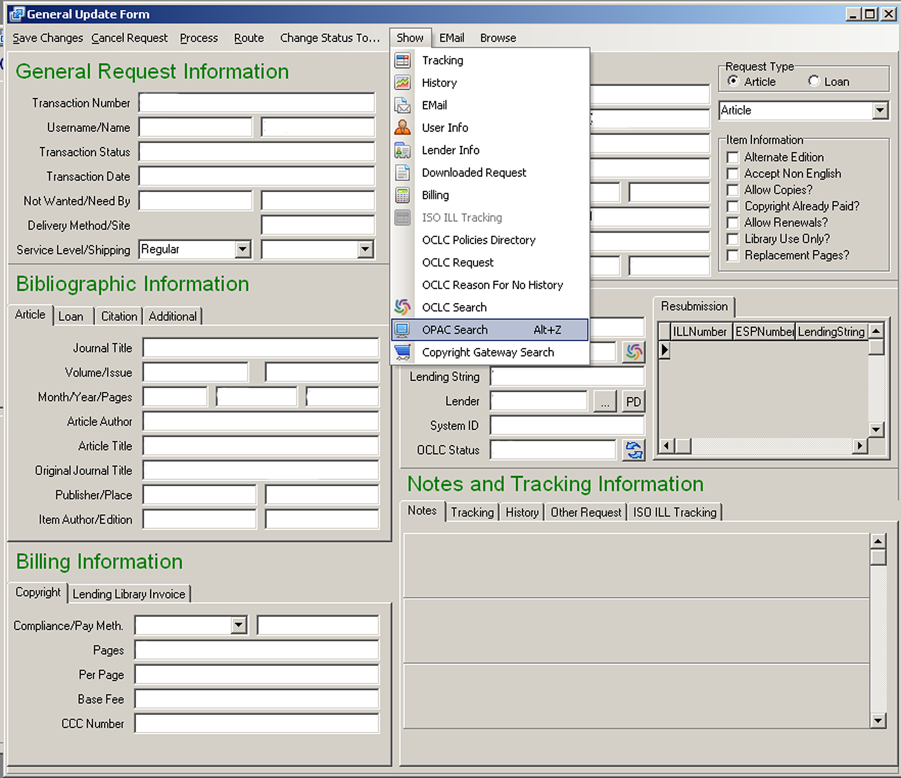
65

Slide 66
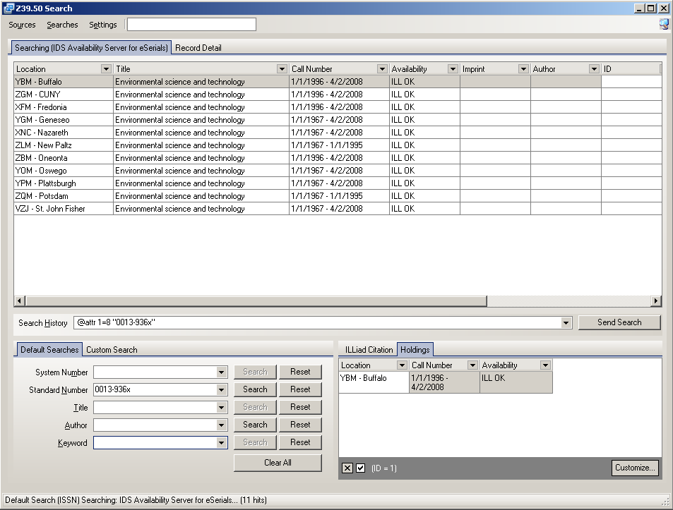
66

Slide 67
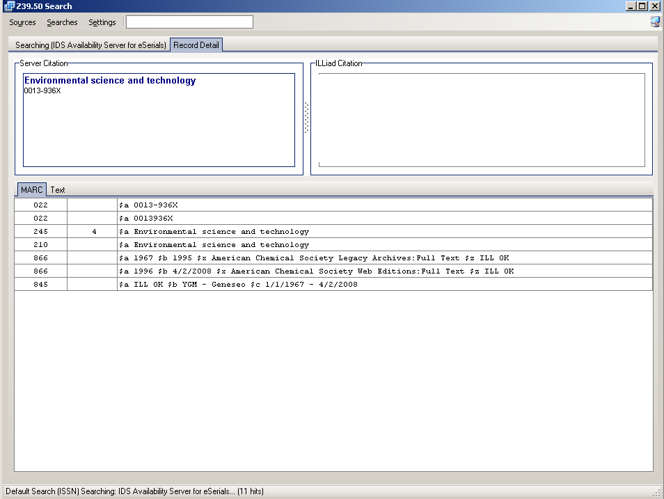
67

Slide 68
Text
68
2008 IDS Conference

Slide 69
Text
69
2008 IDS Conference

Slide 70
Text
70
2008 IDS Conference

Slide 71
Text
71
2008 IDS Conference

Slide 72
Text
72
2008 IDS Conference

Slide 73
Text
73
2008 IDS Conference

Slide 74
